Slide 1
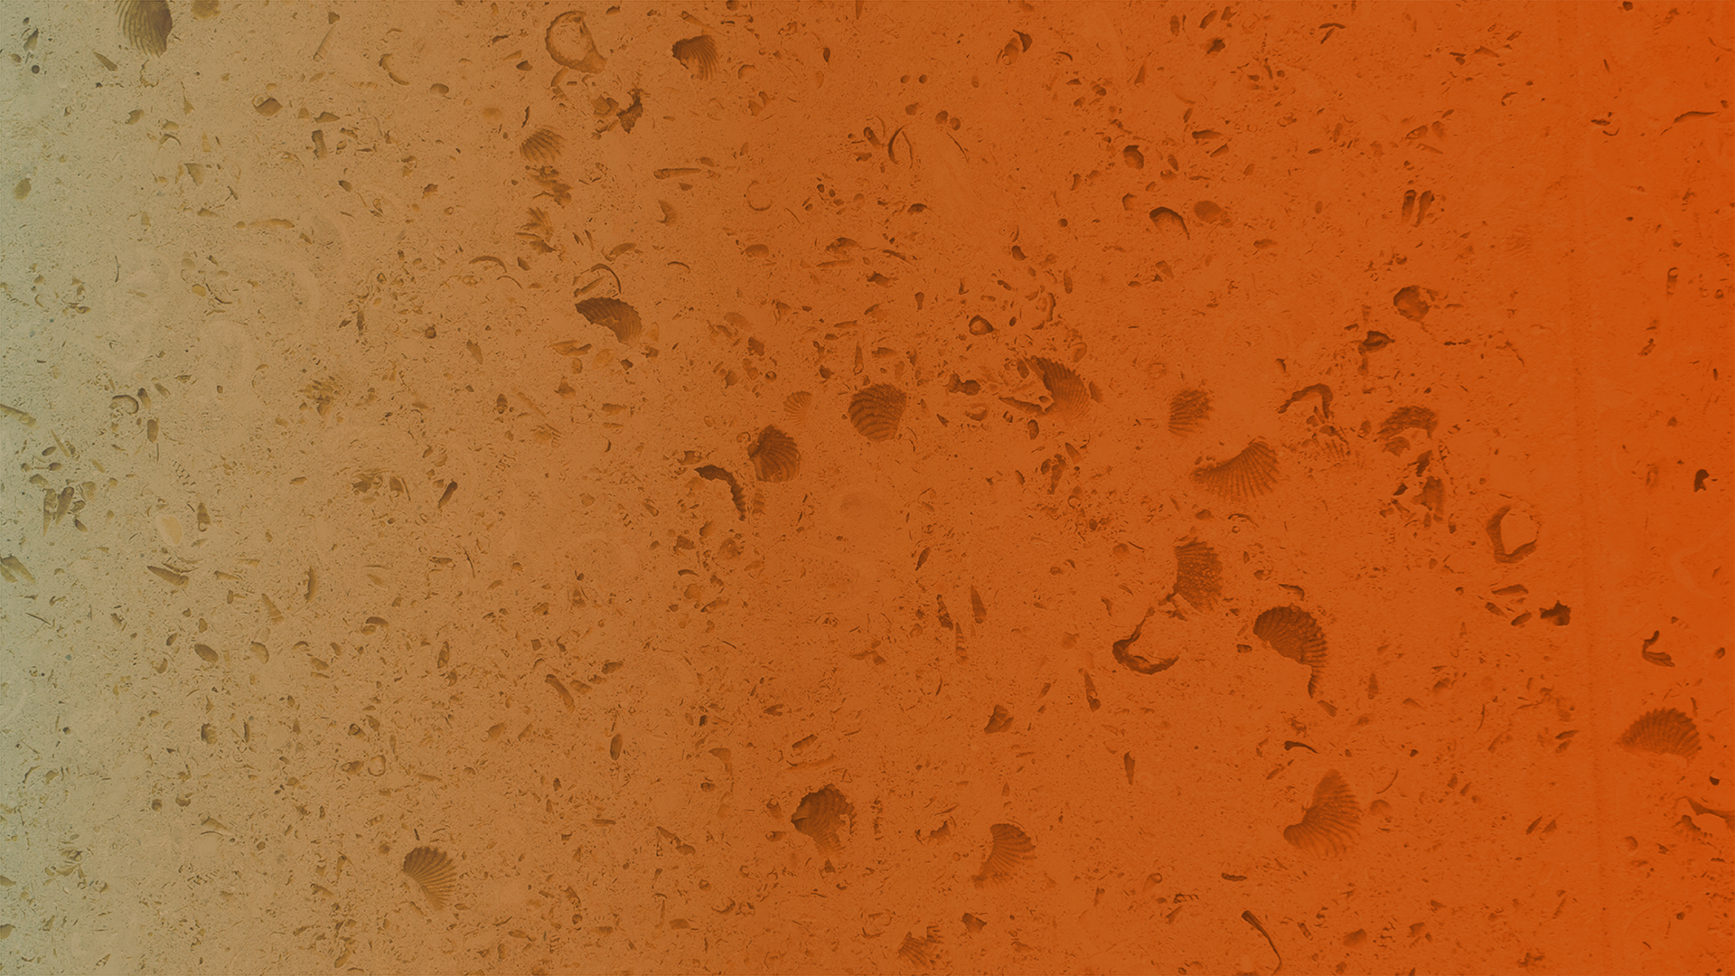

November 2025
Analysis of Well Depths from 1920-2023 for the Major Aquifers of Texas
Finley Davis & M. Bayani Cardenas
Undergraduate Honors Thesis Presentation, The University of Texas at Austin
Notes:
This study investigates how groundwater well depths have changed over the past century in the Major Aquifers of Texas.

Slide 2
Overview
1
2
3
4
Intro
Methods
Results/Discussion
Conclusion

Slide 3
Intro

Slide 4
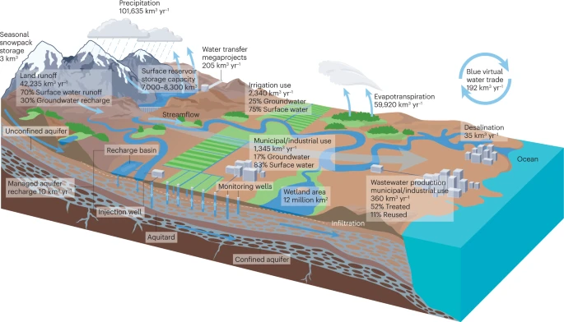
Groundwater is a critical global resource
Acts as a buffer against climate variability
In Texas, groundwater provides >50% freshwater annually (George et al., 2011)
31 million Texans + 2.7 trillion-dollar economy are reliant upon this resource
(U.S. Census Bureau, 2024;
Bureau of Economic Analysis, 2024)
Figure 1: Simplified representation of the hydrologic cycle (Scanlon et al., 2023)

Slide 5
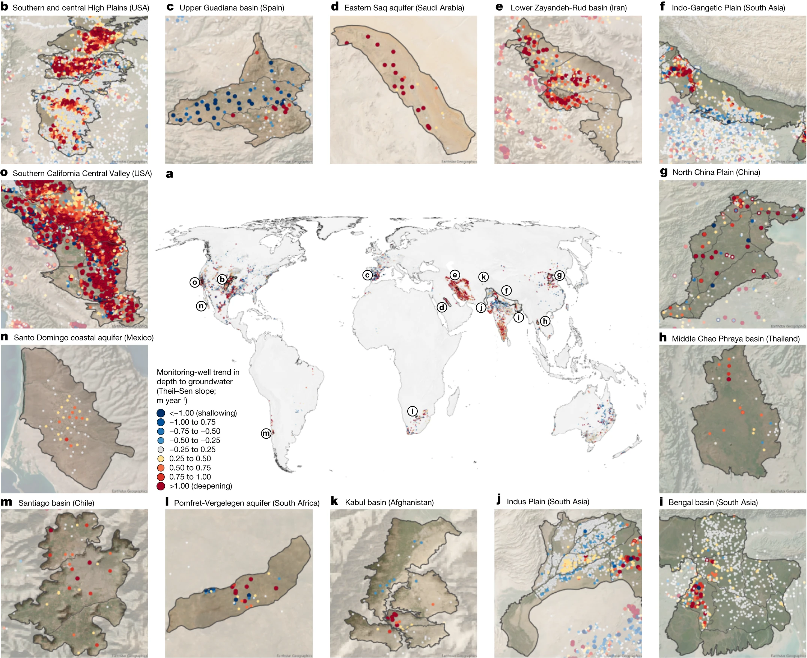
Texas is a global hotspot for groundwater depletion (Jasechko et al., 2024; Scanlon et al., 2023)
Depletion can lead to reduced water supply in agriculture and cities, as well as ecosystem degradation
Figure 2: Global groundwater level trends of the twenty-first century collected from monitoring wells (Jasechko et al., 2024)

Slide 6
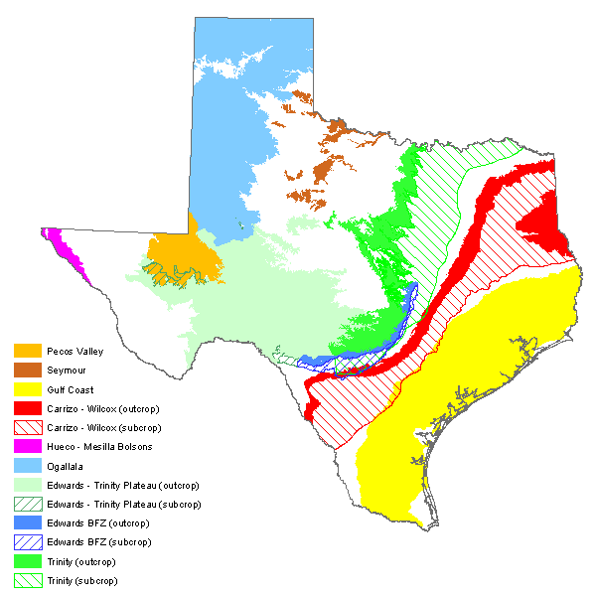
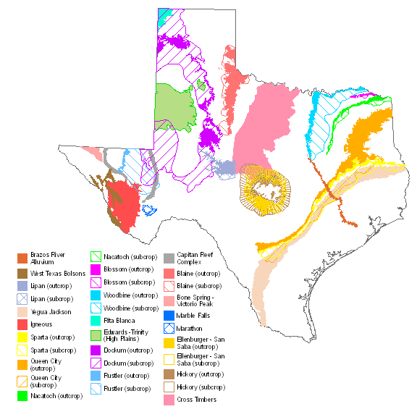
Texas Groundwater Resources
Nine major and twenty-two minor aquifers (Texas Water Development Board, n.d.)
Figure 5: Nine Major Texas Aquifers (Texas Water Development Board, n.d. –a)
Figure 6: Twenty-Two Minor Texas Aquifers (Texas Water Development Board, n.d. –b)

Slide 7
Groundwater Depletion in Texas
Magnitude of depletion will likely increase (Gorelick & Zheng, 2015; Wada et al., 2010 ; World Water Assessment & UN-Water, 2009)
When water levels decline, wells can run dry
Possibility of economic ruin and lack of drinking water source (Jasechko & Perrone, 2021; Perrone & Jasechko, 2017)

Slide 8
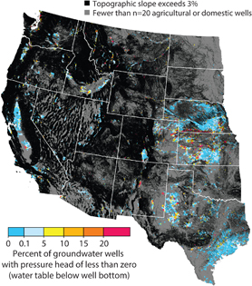
Previous Work
Dry wells were found in greater concentrations in rural areas with intensive agriculture (Perrone & Jasechko, 2017)
Globally, millions of wells at risk of running dry if water levels decline by even a few meters (Jasechko & Perrone, 2021)
Figure 7: Dry groundwater wells in the western US (Perrone & Jasechko, 2017)

Slide 9
Methods

Slide 10
Data Collection
Texas Water Development Board Groundwater Database (TWDB GWDB)
Filtered based on four key attributes
Aquifer Code
Location (Long, Lat)
Depth
Date of Construction
Figure 5: Nine Major Texas Aquifers (Texas Water Development Board, n.d. –a)

Slide 11
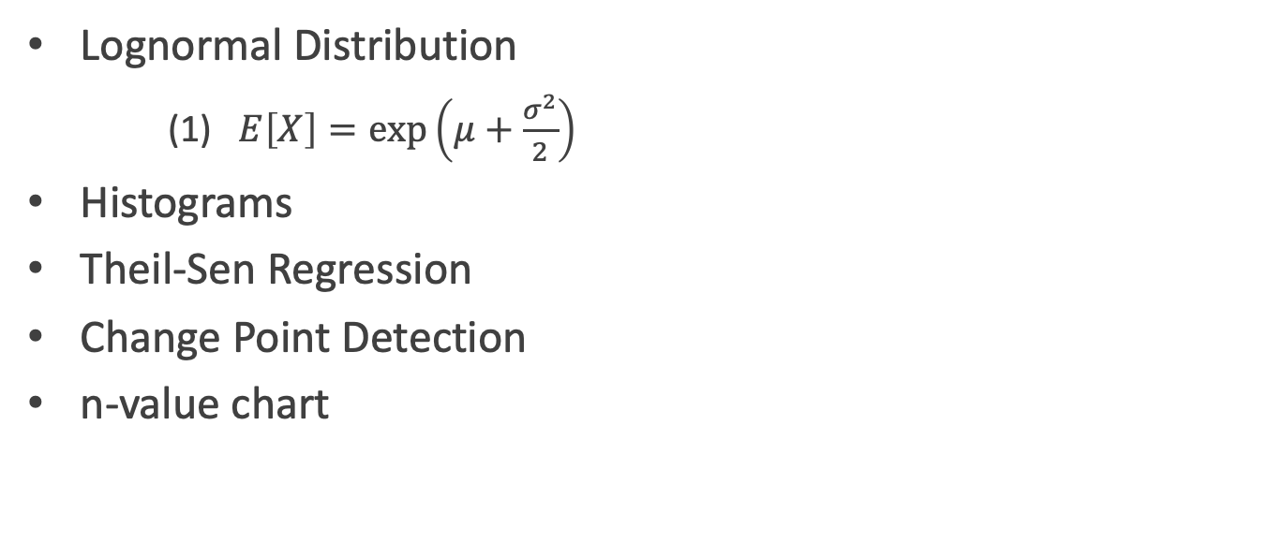
Statistical Framework and Visualization
Lognormal Distribution
(1) $E\left[X\right]=\exp\left(μ+\frac{σ^{2}}{2}\right)$
Histograms
Theil-Sen Regression
Change Point Detection
n-value chart
Figure 8: Histogram of one year of well depth data in the Ogallala Aquifer showing a lognormal (positively skewed) distribution of data

Slide 12
Results

Slide 13
Grouping Data by Aquifer Code
Spatial Distribution of Groundwater Wells from the TWDB GWDB
Nine Major Texas Aquifers
Figure 9: Nine Major Texas Aquifers as depicted by TWDB GWDB Aquifer Code Delineation
Figure 5: Nine Major Texas Aquifers (Texas Water Development Board, n.d. –a)

Slide 14
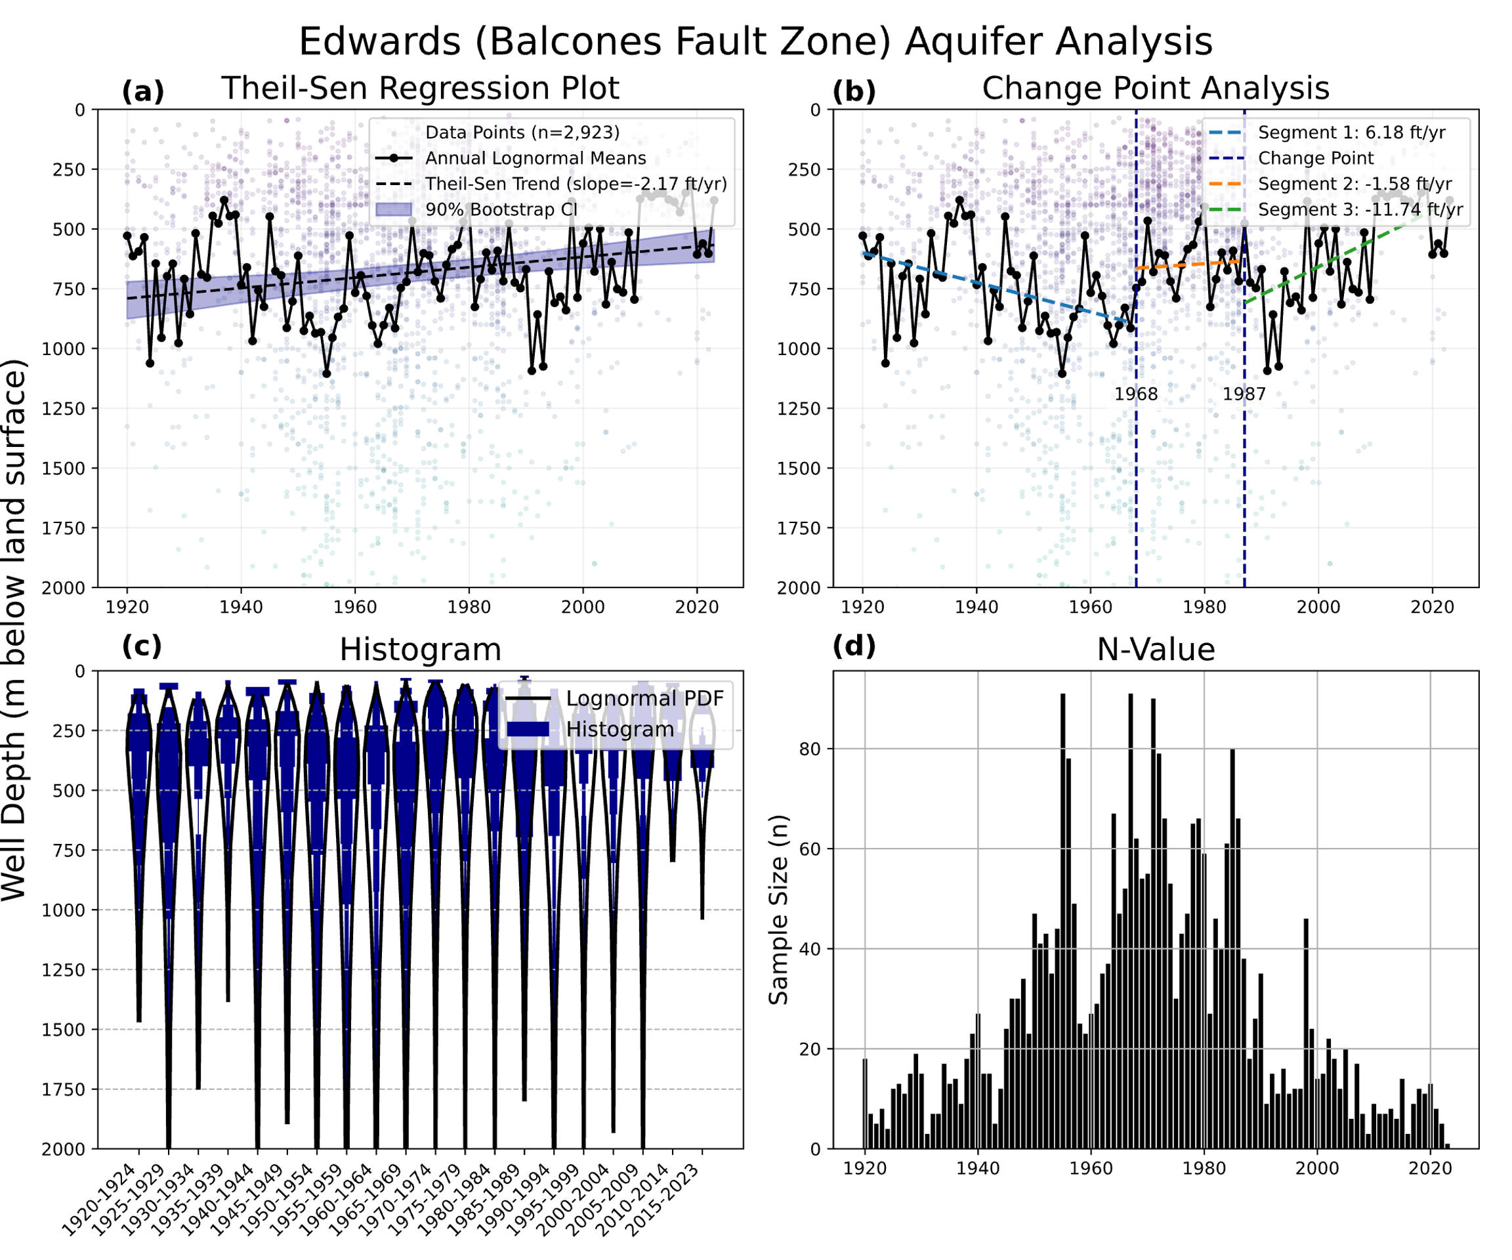
Spatial Distribution of Groundwater Wells from the TWDB GWDB
Figure 9: Nine Major Texas Aquifers as depicted by TWDB GWDB Aquifer Code Delineation
Figure 10: Analysis of Edwards BFZ Aquifer well depth trends from 1920-2023 using (a) Theil-Sen Regression (b) Change-Point Analysis (c) Overturned Histograms (d) n-value chart
Notes:
Jasechko & Perrone, 2021 finds that well depths often do not correlate with groundwater depletion. In a lot of places that have faced depletion, wells are drilled to the same depth of the current well, or even shallower
municipal, industrial, and irrigation purposes

Slide 15
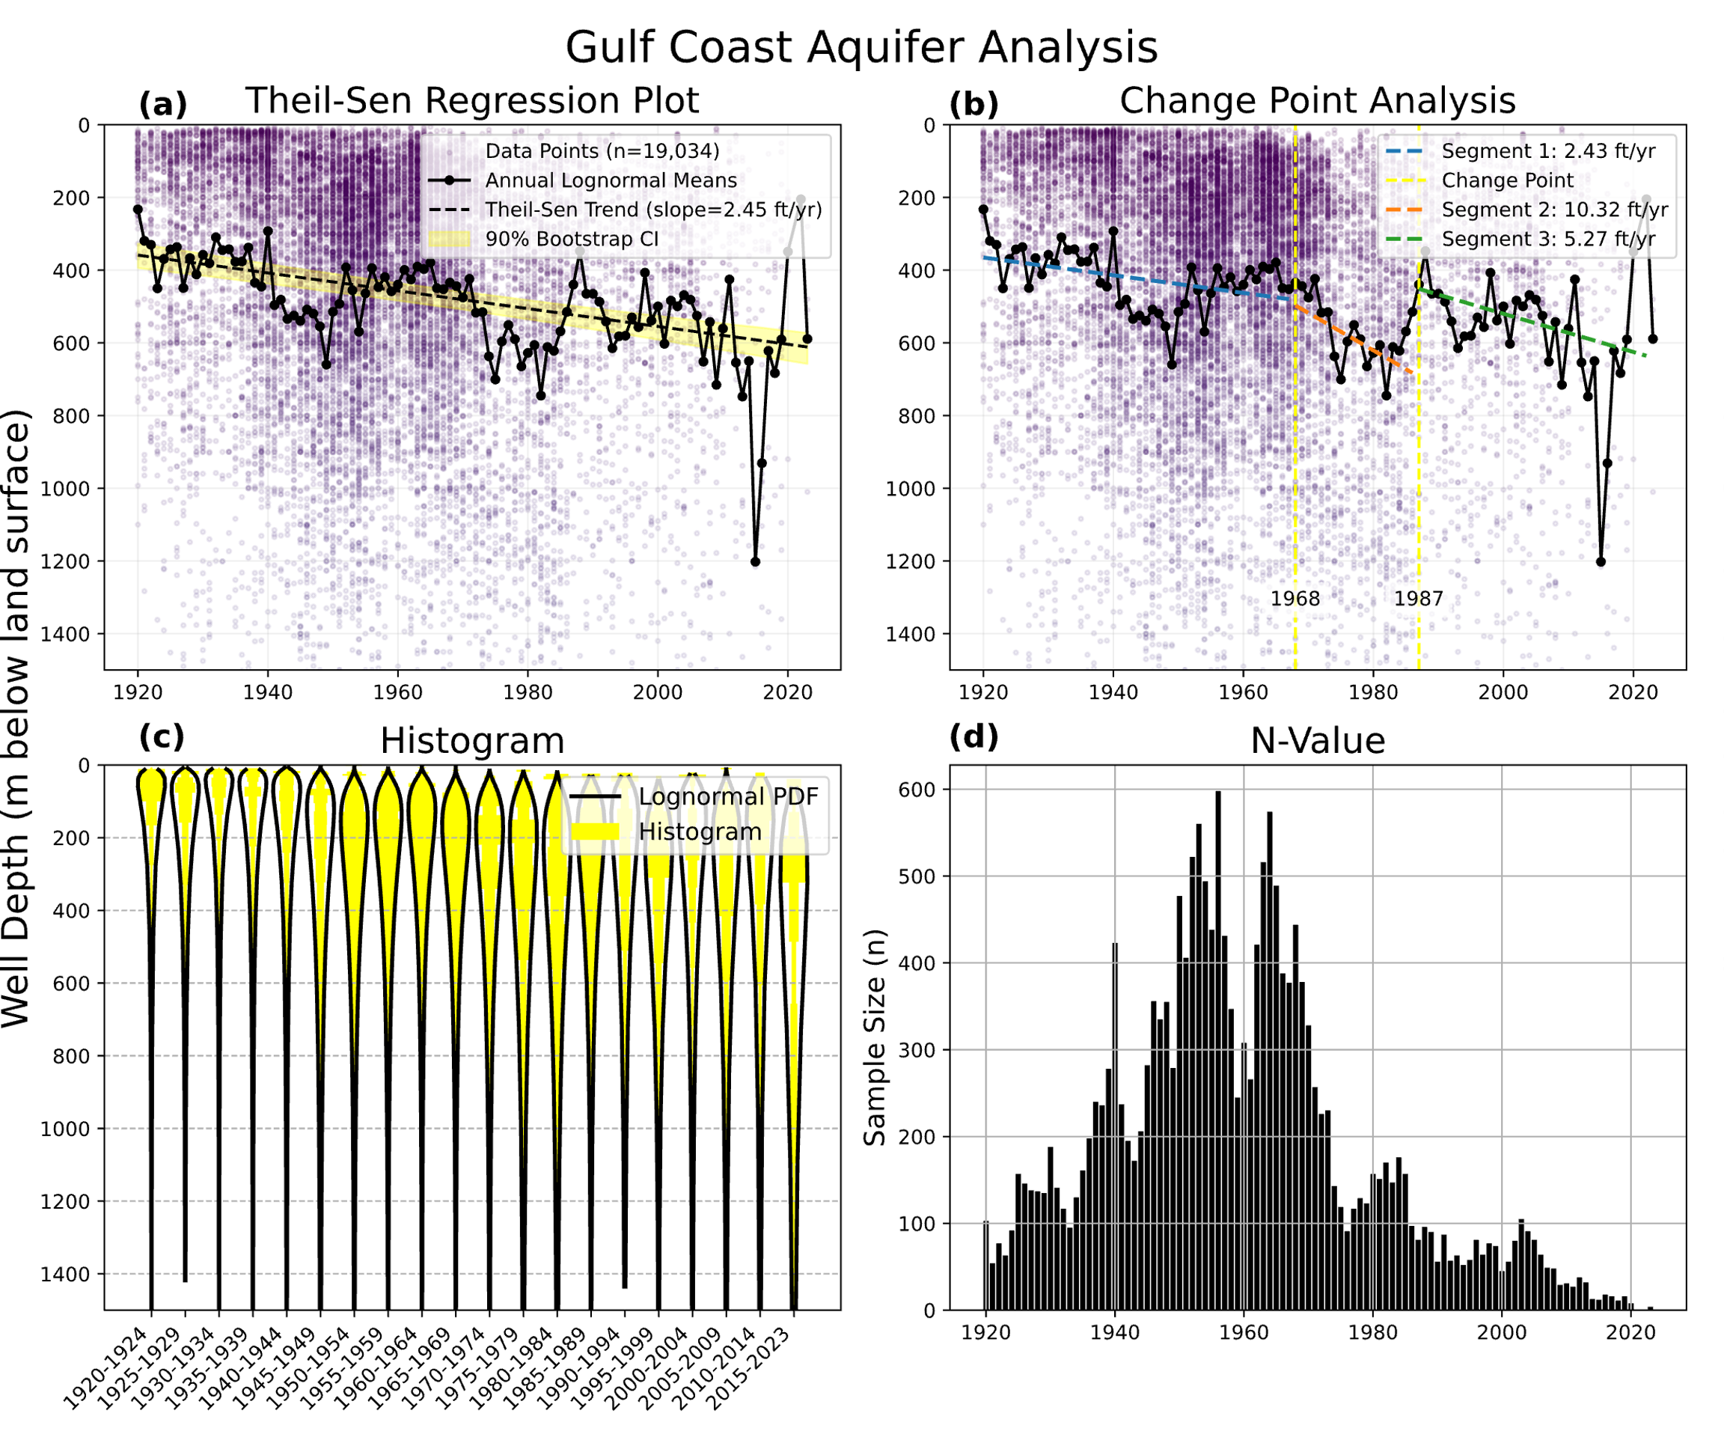
Spatial Distribution of Groundwater Wells from the TWDB GWDB
Figure 9: Nine Major Texas Aquifers as depicted by TWDB GWDB Aquifer Code Delineation
Figure 11: Analysis of Gulf Coast Aquifer well depth trends from 1920-2023 using (a) Theil-Sen Regression (b) Change-Point Analysis (c) Overturned Histograms (d) n-value chart
Notes:
municipal, industrial, and irrigation purposes

Slide 16
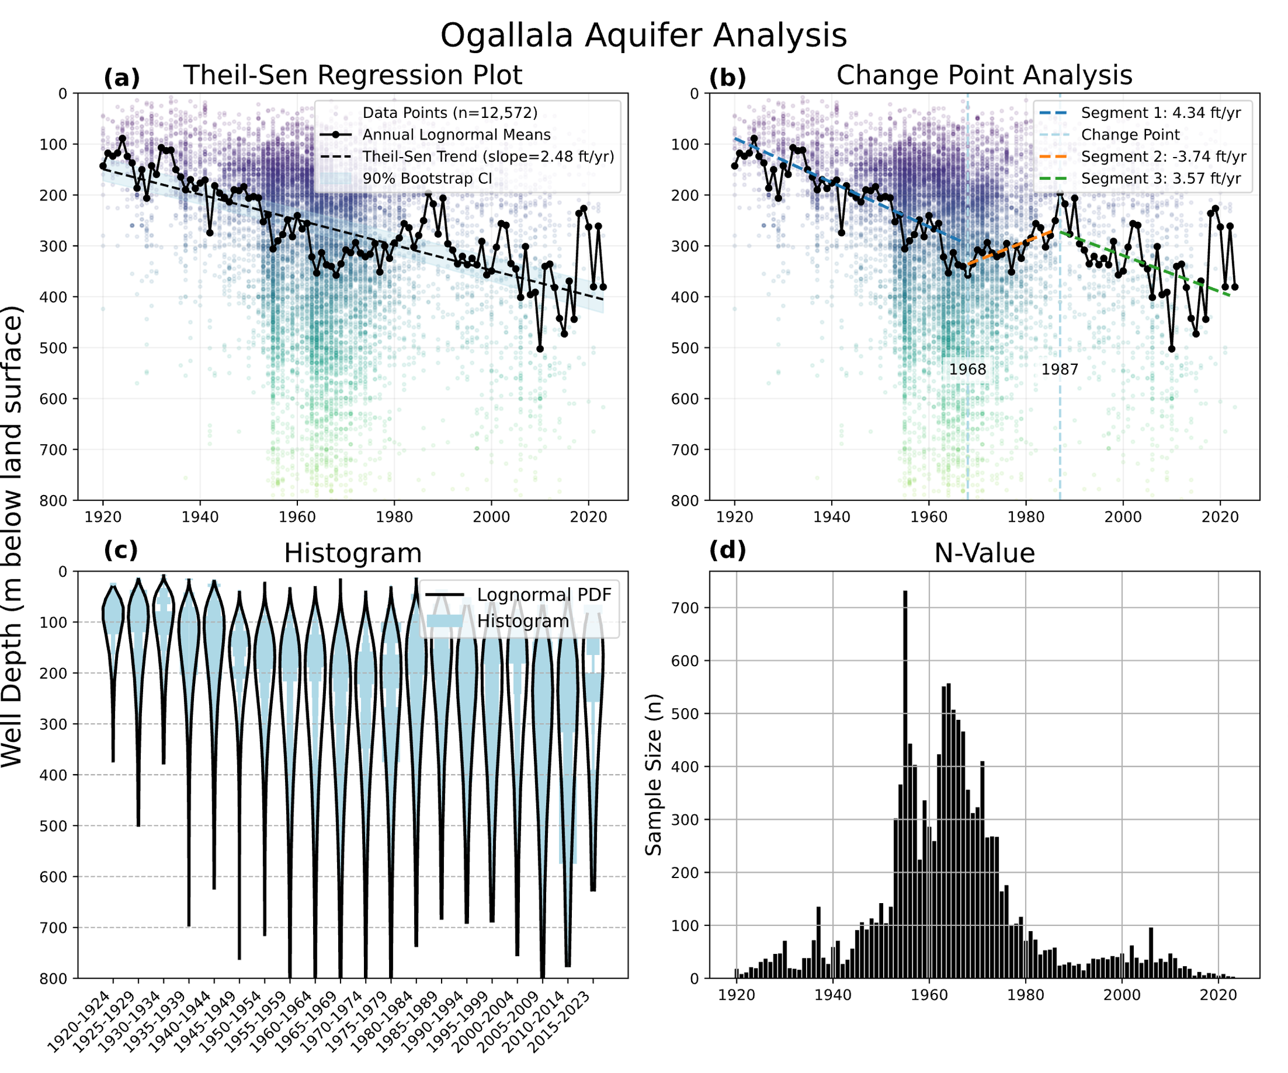
Spatial Distribution of Groundwater Wells from the TWDB GWDB
Figure 9: Nine Major Texas Aquifers as depicted by TWDB GWDB Aquifer Code Delineation
Figure 12: Analysis of Ogallala Aquifer well depth trends from 1920-2023 using (a) Theil-Sen Regression (b) Change-Point Analysis (c) Overturned Histograms (d) n-value chart

Slide 17
Summary Table
Aquifer | T-S Slope (ft/yr)
Ogallala | 2.4847
Edwards (Balcones Fault Zone) | -2.1706
Edwards-Trinity Plateau | 1.9262
Carrizo-Wilcox | 0.7926
Gulf Coast | 2.4522
Pecos Valley | 1.9956
Seymour | 0.2747
Trinity | 0.6476
Hueco-Mesilla Bolsons | 1.8474
8/9 major Texas aquifers show a deepening well depth trend over the past century
Table 1: Results of Theil-Sen regression over a century of well depth data for Texas Aquifer

Slide 18
Limitations and Data Issues
More data is needed for a better understanding of well depth trends
The TWDB GDWB is only representative of ~10% of the total number of groundwater wells
Current analyses do not capture localized well deepening trends

Slide 19
Future Work
Analysis of Texas minor aquifers
More localized analyses of well depth trends within given aquifers

Slide 20
Conclusions
Most Texas aquifers (8/9) show increasing well depths over time
Deeper wells indicate decreased access to groundwater resources in the state of Texas
Data gaps limit accuracy of analysis in some aquifers

Slide 21
Acknowledgements
Thank you to Bayani for guiding my work, to Ashley, and to Jaime and Rich for making this possible. Also, thank you to my peers.
Thanks to earlier work done by Zachary Mungia and Drazen Medina; their research served as a jumping off point for my work on this study

Slide 22
References
George, P. G., Mace, R. E., & Petrossian, R. (2011). Aquifers of Texas (Vol. 380, pp. 1-182).
Austin, TX: Texas Water Development Board.
Wagner, M. W., & Kreuter, U. P. (2004). Groundwater supply in Texas: private land
considerations in a rule-of-capture state. Society and Natural Resources, 17(4), 349-357.
Jasechko, S., Seybold, H., Perrone, D., Fan, Y., Shamsudduha, M., Taylor, R. G., ... & Kirchner,
J. W. (2024). Rapid groundwater decline and some cases of recovery in aquifers globally. Nature, 625(7996), 715-721.
Scanlon, B. R., Fakhreddine, S., Rateb, A., de Graaf, I., Famiglietti, J., Gleeson, T., ... & Zheng,
C. (2023). Global water resources and the role of groundwater in a resilient water future. Nature Reviews Earth & Environment, 4(2), 87-101.
Wada, Y., Van Beek, L. P., Van Kempen, C. M., Reckman, J. W., Vasak, S., & Bierkens, M. F.
(2010). Global depletion of groundwater resources. Geophysical research letters, 37(20).
Konikow LF. Long‐term groundwater depletion in the United States. Groundwater. 2015 Jan;53(1):2-9.
U.S. Census Bureau. (2024). Annual and cumulative estimates of residential population
change for the United States, regions, states, District of Columbia, Puerto Rico. Retrieved December 20, 2024, from http://census.gov/data/tables/time-series/demo/popest/2020s-national-total.html
Bureau of Economic Analysis. (2024, March 28). Gross domestic product by state and personal
income by state, 4th quarter 2023 and preliminary 2023 [PDF]. U.S. Department of Commerce. https://www.bea.gov/sites/default/files/2024-03/stgdppi4q23-a2023.pdf
Texas Water Development Board. (n.d.) -a. Major aquifers. Texas Water Development Board. Retrieved Nov 2, 2025, from https://www.twdb.texas.gov/groundwater/aquifer/major.asp
Texas Water Development Board. (n.d.) -b. Minor aquifers. Texas Water Development Board. Retrieved Nov 2, 2025, from https://www.twdb.texas.gov/groundwater/aquifer/minot.asp
Texas Water Development Board. (n.d.) -c. Groundwater data. https://www.twdb.texas.gov/groundwater/data/index.asp
Jasechko, S., & Perrone, D. (2021). Global groundwater wells at risk of running dry. Science, 372(6540), 418-421.
Perrone, D., & Jasechko, S. (2017). Dry groundwater wells in the western United States. Environmental Research Letters, 12(10), 104002.
World Water Assessment Programme (United Nations), & UN-Water. (2009). Water in a
changing world.
Scanlon, B. R., Fakhreddine, S., Rateb, A., de Graaf, I., Famiglietti, J., Gleeson, T., ... & Zheng, C. (2023). Global water resources and the role of groundwater in a resilient water future. Nature Reviews Earth & Environment, 4(2), 87-101.

Slide 23
Questions?

